Slide 1
Data Science Project
Insurance Forecast using Machine Learning

Slide 2
DATASET
In this project we are told to find cost of treatment of different patients.
The cost of treatment depends on many factors: diagnosis, type of clinic, city of
residence, age and so on.
We have no data on the diagnosis of patients.
We have other information that can help us to make a conclusion about the health
of patients.
Here, Dataset contains information about patients age , BMI , sex ,
no. of children they have, whether they are smoker or not etc.

Slide 3
Dataset Columns:
Age: age of primary beneficiary
Sex: insurance contractor gender, female, male
BMI: Body mass index, providing an understanding of body, weights that are relatively high or low relative to height.
Children: Number of children covered by health insurance / Number of dependents
Smoker: Does the person smoke or not.
Region: The beneficiary's residential area in the US, northeast, southeast, southwest, northwest.
Charges: Individual medical costs billed by health insurance

Slide 4
Algorithm Description:
Machine Learning is iterative process.
First you try an initial model building based on statistical analysis and then observing the performance of initial model. You try to change model parameters , feature list, size of data and sometime regularizing techniques and changing the algorithm also to improve performance.
Here, first we are using Linear Regression model.
But after observing model performance and dataset we came to know that maybe classification algorithms like Decision Tree or Random forest will work better.

Slide 5
Linear Regression
Linear regression may be defined as the statistical model that analyzes the linear relationship between a dependent variable with given set of independent variables. Linear relationship between variables means that when the value of one or more independent variables will change (increase or decrease), the value of dependent variable will also change accordingly (increase or decrease).
Mathematically the relationship can be represented with the help of following equation −
Y = mX + b
Here, Y is the dependent variable we are trying to predict
X is the dependent variable we are using to make predictions.
m is the slop of the regression line which represents the effect X has on Y
b is a constant, known as the Y-intercept. If X = 0,Y would be equal to b.

Slide 6
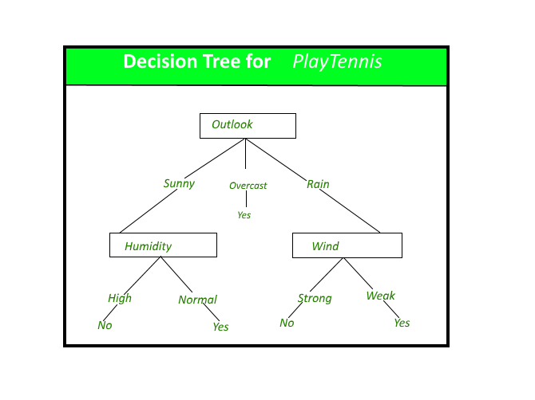
Decision Tree
A Decision tree is a flowchart like tree structure, where each internal node denotes a test on an attribute, each branch represents an outcome of the test, and each leaf node (terminal node) holds a class label.

Slide 7
Random Forest
Random forests is a supervised learning algorithm. It can be used both for classification and regression. It is also the most flexible and easy to use algorithm.
Random forests creates decision trees on randomly selected data samples, gets prediction from each tree and selects the best solution by means of voting. It also provides a pretty good indicator of the feature importance.

Slide 8
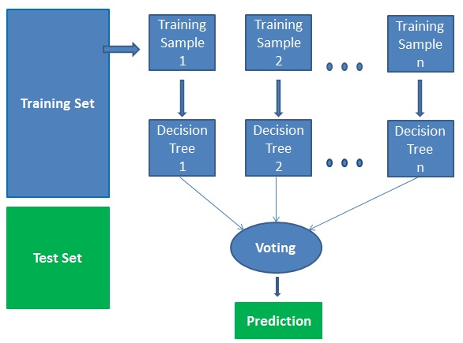

Slide 9
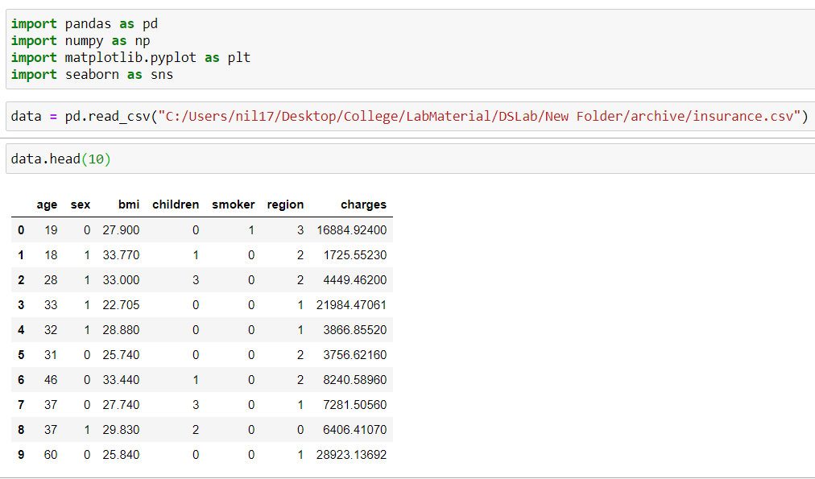
Data Loading

Slide 10
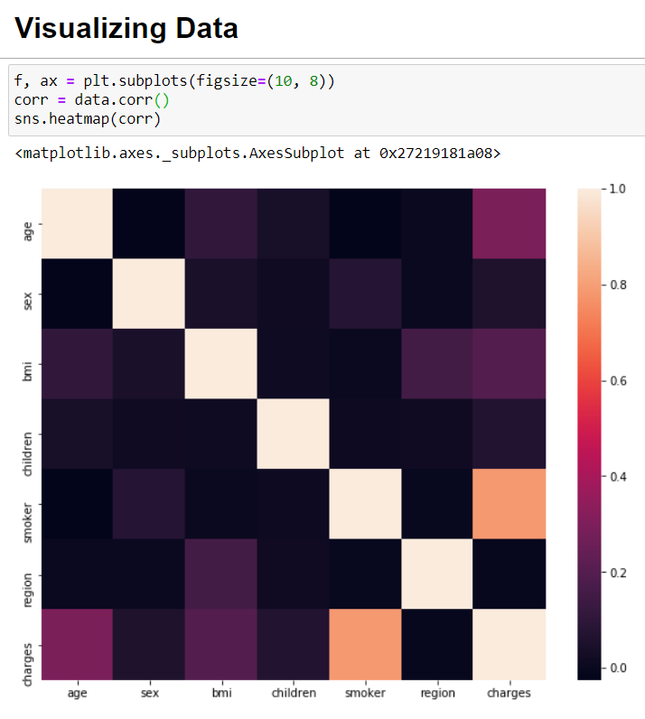

Slide 11
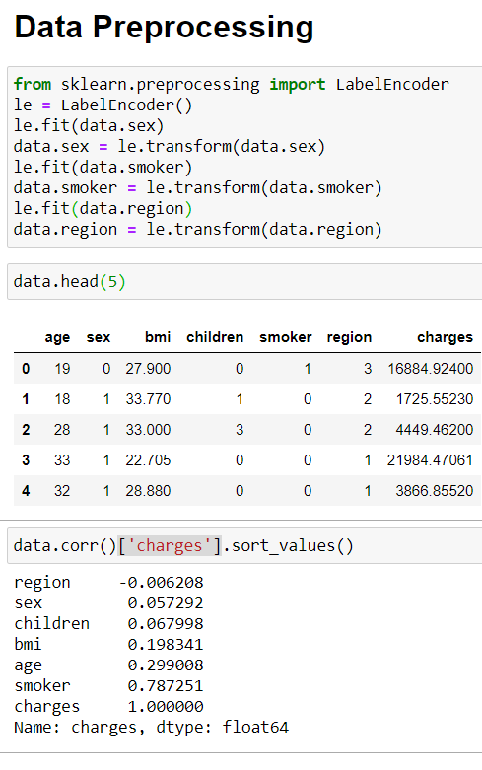

Slide 12
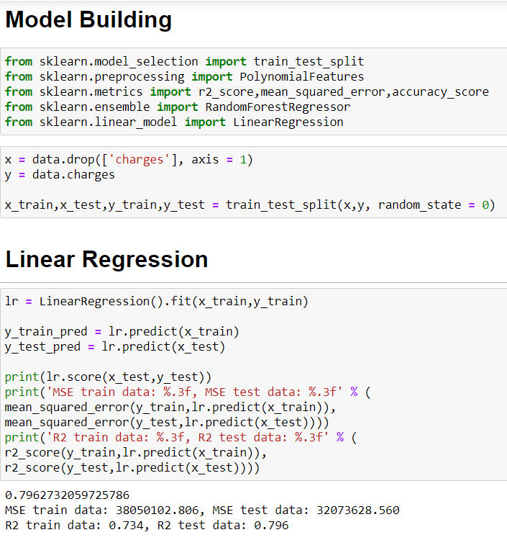
Linear Regression Model

Slide 13
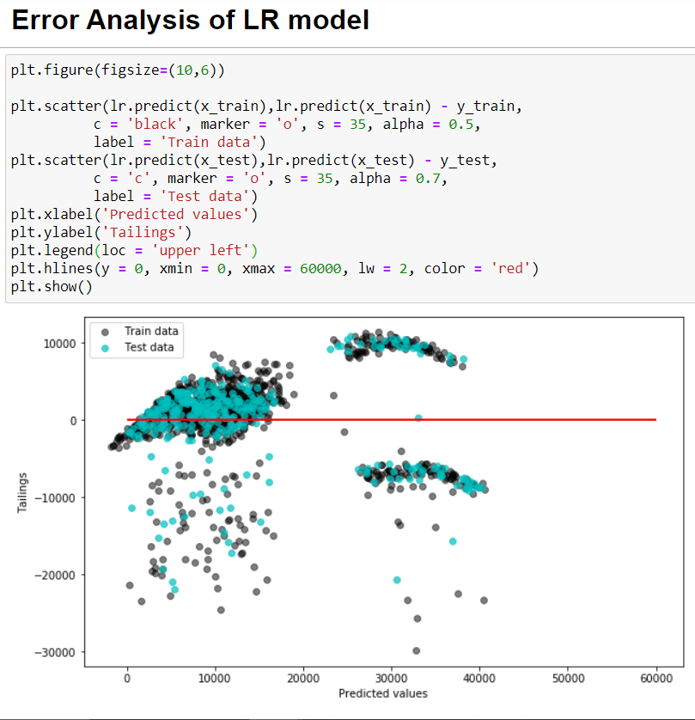

Slide 14
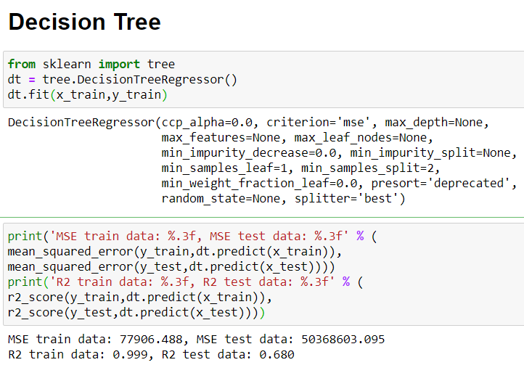
Decision Tree Model

Slide 15
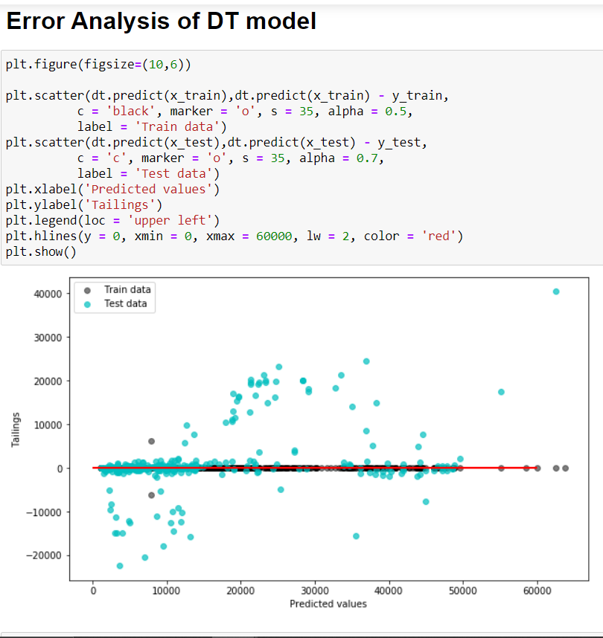

Slide 16
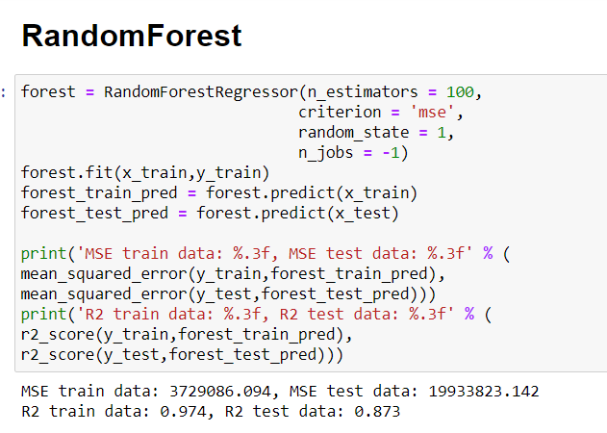
Random Forest Model

Slide 17
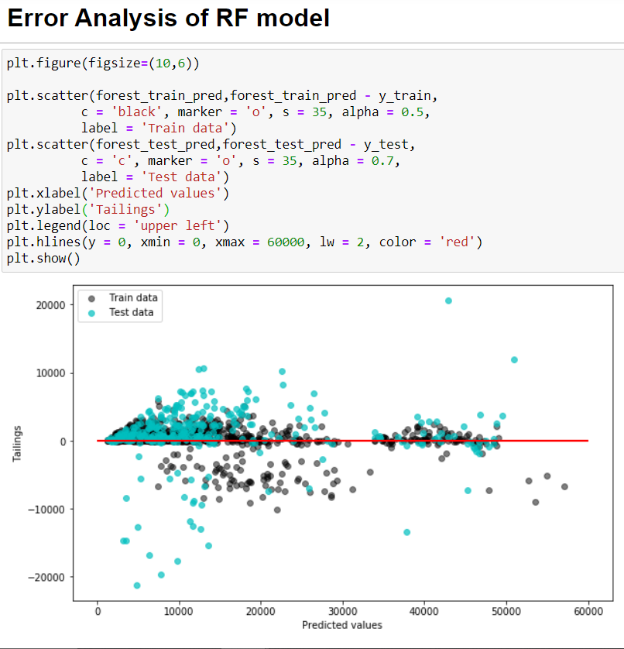

Slide 18
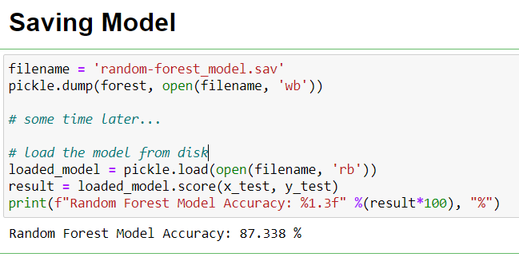
Conclusion
As per our project we got the best performance out from RANDOM FOREST model.
Now, We can save this model for further use.

Slide 19
Thank YOU!

